Slide 1
TASK QUEUE
By David Lozano

Slide 2
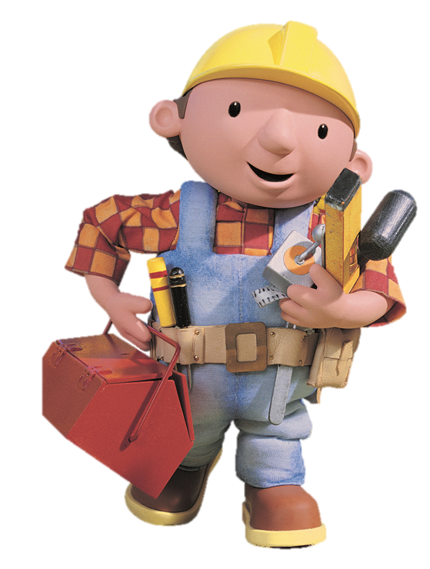
Task
Work handled asynchronously
Task Queue
Push Queue
Pull Queue

Slide 3


Push Queue

Slide 4
Pull Queue
David 32min 29s Metal Slug
Ricard 35min 55s Crysis 3
Yaya 1h 4min Hello Kitty
Roofon 51min 38s Celeste
Cosmo 1h 11min Yoshi Woolly World

Slide 5

Uses in videogames
Chain Commands
Changing the actor of the commands
Redefining Keys
Undo and Redo

Slide 6
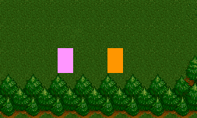

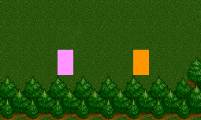


Slide 7
TODO 1
Create a queue of tasks
On this queue we are going to put our commands
USE STD

Slide 8
TODO 2
Create a new class for each task you want to do (one for each direction)
Each Class should have an Execute method
Copy the functions that are already done

Slide 9
TODO 3
Add a new Task to the queue
Pop the first element of the queue
Check if the task is finished and if it is, pop a new element.

Slide 10
TODO 4
Create a new task for each button
Ex: Task* buttonA;
Add a new task to the queue
Remember to delete the new task in the CleanUp

Slide 11

TODO 5
Exchange the controls so when you press A the player goes to the right and so

Slide 12
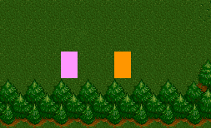
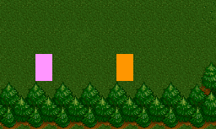

TODO 6
We treat tasks as objects, so we can change the action of the task
Add a new parameter to the Execute() function
When you press Q it should change the actor

